Slide 1
Show, Don’t Tell
Boiling the frog of Continuous Delivery
James Relph
DeliveryConf
22nd January 2020

Slide 2
Digital Platform Engineering
UK Digital Platform Engineering Unit
Working across a number of sectors and technologies
Heavily involved in the UK Public Sector
@jprelph

Slide 3
Show, Don’t Tell
Show, don't tell is a technique used in various kinds of texts to allow the reader to experience the story through action, words, thoughts, senses, and feelings rather than through the author's exposition, summarization, and description.
Wikipedia - https://en.wikipedia.org/wiki/Show,_don't_tell
@jprelph

Slide 4
Show, Don’t Tell
Trying to tell someone that they can achieve CI/CD you can end up fighting against their experience. They may have seen a lot of failed software projects (there’s been a few) and just not think it’s achievable.
If you show them that they can do it then you remove the friction and let them make the move themselves.
@jprelph

Slide 5
Lots of Teams
@jprelph

Slide 6
Different Sizes
@jprelph

Slide 7
Different Skillsets
@jprelph

Slide 8
Different Commercials
£/day
£
£
£
£
£
£/day
£/day
£
£
@jprelph

Slide 9
Building Trust
Reducing cognitive load
Picking the right tools
Prioritise for evidence and metadata
@jprelph

Slide 10
Reducing Cognitive Load
Making things easier gives teams more bandwidth to add value.
Fewer errors are made, building business confidence.
Takes many forms; shared patterns, guilds, SME teams
@jprelph

Slide 11
Sidecars
Pod
External Service
localhost
Tomcat
Nginx
SSL
Ingress Controller
Secrets,
Certs
Secrets
Certs,
Auth
Secret Init
Secret Sidecar
Secret Store
Client
@jprelph
Notes:
Pink - set up by the platform
Green - set up by the platform but configured by the teams
Blue - set up and configured by the teams
Orange - external service

Slide 12
Sidecars
Pod
External Service
localhost
React
Nginx
SSL
Ingress Controller
Secrets,
Certs
Secrets
Certs,
Auth
Secret Init
Secret Sidecar
Secret Store
Client
@jprelph
Notes:
Pink - set up by the platform
Green - set up by the platform but configured by the teams
Blue - set up and configured by the teams
Orange - external service

Slide 13
Picking the right tools
“Big bang” tooling changes are hard and will often need management buy-in
Pick tools that have graceful glide-in
Pick where you fight inertia
Check with all the teams, what’s easy for some may not be easy for others.
As always, don’t let perfect be the enemy of good!
@jprelph

Slide 14


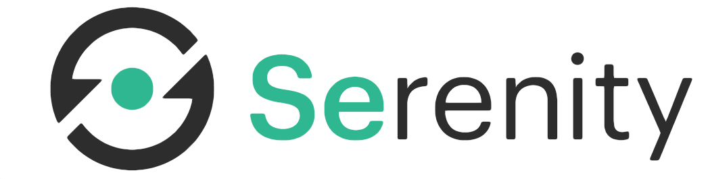
Graceful glide-in
Difficulty
@jprelph

Slide 15


Inertia
Fighting Inertia

Slide 16
Building our pipeline
@jprelph

Slide 17

Building our pipeline
@jprelph

Slide 18
Root causes behind lack of confidence
Deployments were hard, and rolling back was harder.
Integration tests were long and complicated, with environments often requiring manual alignment.
Config was hard to manage and had caused outages in the past.
Problems with a complicated pipeline led to falling back to processes that gave the illusion of control - slowing down the pipeline even further.
@jprelph

Slide 19
Building our pipeline
@jprelph

Slide 20
Helm Gave Us
Packaging an entire service at once
Packaging all the config for a service
Packaging all the metadata about the service
Versioning and Provenance files!
@jprelph

Slide 21
Charts
umbrella
requirements.yaml
Service
Service
Service
Common
@jprelph
Notes:
Helm3 elevates the Common chart pattern to an official feature as Library charts.

Slide 22
Charts
1.1.0
umbrella
requirements.yaml
Service
Service
Service
Common
2.0.1
1.1.2
1.0.0
3.2.1
@jprelph

Slide 23
Charts
1.1.0
umbrella
requirements.yaml
_dev.yaml
_int.yaml
_prod.yaml
_tf.yaml
_release_notes.yaml
Service
Service
Service
Common
2.0.1
1.1.2
1.0.0
3.2.1
@jprelph
Notes:
requirements.yaml is now in Charts.yaml with Helm v3

Slide 24
Values File Templating
{{- if eq .Values.global.hpa.hpa_autoscaling true }}
apiVersion: autoscaling/v1
kind: HorizontalPodAutoscaler
metadata:
name: {{ .Chart.Name }}
namespace: {{ .Values.global.namespace }}
spec:
scaleTargetRef:
apiVersion: apps/v1
kind: Deployment
name: {{ .Chart.Name }}
minReplicas: {{ .Values.global.hpa.minReplicas }}
maxReplicas: {{ .Values.global.hpa.maxReplicas }}
targetCPUUtilizationPercentage: {{ .Values.global.hpa.targetcpuutilization }}
global:
logback:
level: DEBUG
hpa:
hpa_autoscaling: true
minReplicas: 1
maxReplicas: 2
targetcpuutilization: 75
@jprelph
Notes:
Go/Sprig templating

Slide 25
Common Chart
{{- define "common.deploy-metadata" -}}
metadata:
name: "{{ .Chart.Name }}"
labels:
name: {{ .Chart.Name }}
chart: {{ include "common.chart" . }}
release: {{ .Release.Name }}
heritage: {{ .Release.Service }}
service: Team1-{{ .Chart.Name }}
billing: TEAM
{{- end -}}
apiVersion: apps/v1beta2
kind: Deployment
{{ template "common.deploy-metadata" . }}
{{ template "common.deploy-spec" . }}
{{- end -}}
@jprelph
Notes:
Go/Sprig templating

Slide 26
Charts
1.1.0
umbrella
Service
Service
Service
Common
2.0.1
1.1.2
1.0.0
3.2.1
_dev.yaml
_int.yaml
_prod.yaml
_release_notes.yaml
@jprelph

Slide 27
Charts
1.1.0
umbrella
Service
Service
Service
Common
2.0.1
1.1.2
1.0.0
3.2.1
_deployment.yaml
_ingress.yaml
_service.yaml
_proxy.yaml
@jprelph

Slide 28
_release_notes.yaml
Chart release 1.1.0
Chart release 1.1.1
Tag
Commits
Tag
@jprelph
Notes:
We hoover up the commits between two tags using git history and throw them into the _release_notes.yaml files. One thing to note is that Helm will include (but ignore) _underscore.yaml files, but we initially tried this with a _release_notes.txt file and Helm stripped the file out completely (haven’t confirmed this is still the case with Helm3).

Slide 29
Commit
git commit -m “TKN-0101 Update Xmx”
@jprelph

Slide 30
Commit
git commit -m “Fix Typo”
@jprelph

Slide 31
Commit
git commit -m “Fix Typo Again”
@jprelph

Slide 32
Charts
umbrella
1232 - C
1454 - D
1233 - F
11298 - L
Service
Service
Service
Common
1232 - C
1454 - D
1233 - F
11298 - L
1232 - C
1454 - D
1233 - F
11298 - L
1232 - C
1454 - D
1233 - F
11298 - L
1232 - C
1454 - D
1233 - F
11298 - L
@jprelph

Slide 33
Charts
umbrella
1232 - C
1454 - D
1233 - F
11298 - L
Service
Service
Service
Common
1232 - C
1454 - D
1233 - F
11298 - L
1232 - C
1454 - D
1233 - F
11298 - L
1232 - C
1454 - D
1233 - F
11298 - L
1232 - C
1454 - D
1233 - F
11298 - L
Collate and
Deduplicate
@jprelph

Slide 34
_tf.yaml Example
tf_name: team-name
tf_version: “5.1.1”
tf_path: “/team-name"
TestEnvironment:
int1:
TestJobBranch: master
TestJobTags: "@int1 or @perfTest"
int2:
TestJobBranch: master
TestJobTags: "@int2"
RegressionBreaking: False
CycleTime: 2
LiveProve: False
Dependencies:
team1: 1.2.3
team2: ~1.5.0
team3: >=1.0.0
@jprelph
Notes:
An example format, shows how you can build your own data/metadata into charts to control other functions.

Slide 35
Original Pipeline
dev
integration1
integration2
performance
prod
team1
v3
v3
v3
v2
v2
team2
v3
v3
v2
v2
v1
team3
v2
v2
v1
v1
v1
team4
v2
v1
v1
v1
v1
config
@jprelph

Slide 36
Original Pipeline
dev
integration1
integration2
performance
practice
prod
team1
v3
v3
v3
v3
v2
v2
team2
v3
v3
v2
v2
v1
v1
team3
v2
v2
v1
v1
v1
v1
team4
v2
v1
v1
v1
v1
v1
config
@jprelph

Slide 37
Core Pipeline
dev/feat
integration1
integration2
prod
team1
v3
Virtual
Release
Point
v3
v3
v2
team2
v2
Watch
v1
v1
v1
CORE
team3
v2
v1
v1
v1
Orchestrate
team4
v2
v1
v1
v1
Release candidates are specified with chart metadata (eg. +rc) which allows teams to test/utilise charts and store them in Chart Museum without triggering the pipeline - eg. 1.1.2+rc
@jprelph

Slide 38
Core Pipeline
dev/feat
integration1
integration2
prod
team1
v3
Virtual
Release
Point
v2
v3
v2
v3
v2
team2
v2
Watch
v2
v2
v1
CORE
team3
v2
v1
v1
v1
Orchestrate
team4
v2
v1
v1
v1
@jprelph

Slide 39
Core Pipeline
dev/feat
integration1
integration2
prod
team1
v3
Virtual
Release
Point
v3
v3
v2
team2
v2
Watch
v2
v2
v1
CORE
team3
v2
v1
v1
v1
Orchestrate
team4
v2
v1
v1
v1
@jprelph
Notes:
This can be overridden in the _ctf.yaml file to enable testing against new versions, or, when required, against multiple versions.

Slide 40
Core Pipeline
dev/feat
integration1
integration2
prod
team1
v3
Virtual
Release
Point
v2
v3
v2
v3
v2
team2
v2
Watch
v2
v1
v1
CORE
team3
v2
v1
v1
v1
Orchestrate
team4
v2
v1
v1
v1
@jprelph
Notes:
If we need to test both versions the fact that the config for these is baked into the charts makes this MUCH simpler to achieve.

Slide 41
Core Pipeline
dev/feat
integration1
integration2
prod
team1
v3
Virtual
Release
Point
v3
v3
v2
team2
v2
Watch
v2
v1
v1
CORE
team3
v2
v1
v1
v1
Orchestrate
team4
v2
v1
v1
v1
2.0.0+int
@jprelph
Notes:
Where teams are doing some specific investigations the semver metadata can also cause a truncated release (ie. to just do some investigative tests in integration1). This feature was mainly used during the startup phase and we prefer Hello World/Dark Releases now.

Slide 42
Core Pipeline
dev/feat
integration1
integration2
prod
team1
v3
Virtual
Release
Point
v2
v3
v2
v3
v2
v3
team2
v2
Watch
v2
v1
v1
CORE
team3
v2
v1
v1
v1
Orchestrate
team4
v2
v1
v1
v1
2.0.0+can
_canary.yaml in Umbrella
@jprelph
Notes:
Semver metadata was also used to specify canary and dark releases (our dark releases are effectively canaries scaled to 0)

Slide 43
Core Pipeline
CORE
dev/feat
integration1
integration2
prod
team1
v3
Virtual
Release
Point
v2
v3
v2
v3
v2
v3
team2
v2
Watch
v2
v1
v1
team3
v2
v1
v1
v1
Orchestrate
team4
v2
v1
v1
v1
2.0.0+can
_canary.yaml in Umbrella
@jprelph
@jprelph

Slide 44
What the core pipeline achieved
Teams loved it (less work for them!)
We have several assurance levels; the charts can’t be changed between environments, we know exactly what tests were run against what other deployed versions and we know the config wasn’t changed (and as the config is in one place, in a defined standard, we can test the config).
Removes significant numbers of manual steps.
Massive improvement in business confidence.
@jprelph

Slide 45
Our main dependency
This only works if our tests are reliable and fast
@jprelph

Slide 46
Test Framework
@jprelph

Slide 47
Our Test Framework
Wraps our tests within Serenity BDD Framework
Includes Jmeter (replacing with Locust), Selenium, Postman etc.
Deployed within Kubernetes as controller-less pods
Which tests to run and how is pulled back from the _tf.yaml file.
One test, one pod
Can be run locally (within Docker for Desktop/minikube)
@jprelph

Slide 48
1T1P
UI
UI
UI
UI
UI
Tests (git)
CORE
Perf
Perf
Perf
Perf
Rightsize
By type
API
API
API
API
@jprelph

Slide 49
1T1P
UI
UI
UI
UI
UI
Tests (git)
Perf
Perf
Perf
Perf
API
API
API
API
@jprelph

Slide 50
1T1P
UI
UI
UI
UI
UI
ConfigMap
1 Complete
2 Complete
3 Complete
…
Perf
Perf
Perf
Perf
API
API
API
API
@jprelph

Slide 51
1T1P
UI
UI
UI
UI
UI
ConfigMap
1 Complete
2 Complete
3 Complete
…
Perf
Perf
Perf
Perf
API
API
API
API
Triggers Collation
@jprelph

Slide 52
Our Test Framework
Tests are output to S3 by each pod
A ConfigMap is used for coordination between pods
The final pod runs the serenity aggregate command to bundle the results together.
Combined with the _release_notes.yaml data and sent to Confluence.
@jprelph

Slide 53
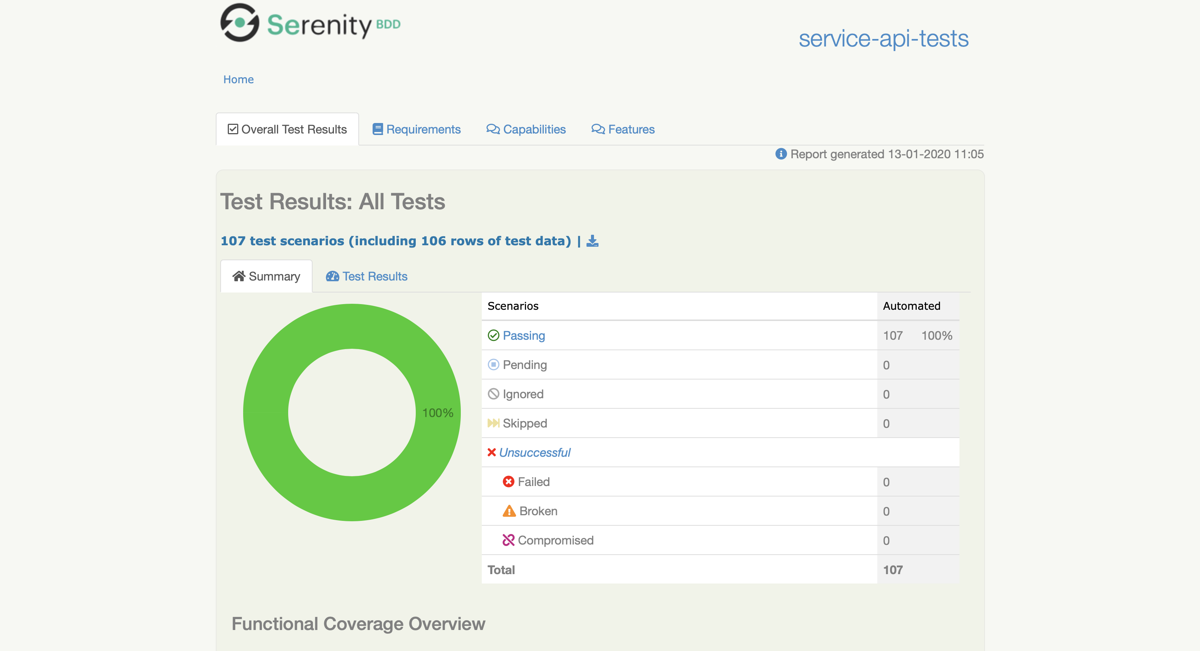
Visual Output
@jprelph

